Slide 1


Slide 2
Intro
Since the data resides in a single place, it can be a single point of failure. If the infrastructure fails, the
data is lost forever. Think of a hard disk failure you have then, how can you retrieve it back and how
quickly you can repair it. In reality, it is completely intolerable from enterprises perspective. Millions
of customers will be lost if the site is down for an hour. To make this system more secure, it is always
better to have redundant data that will quickly help us to make everything immediately work.
Generally, companies having tons and tons of data will store all of them in databases, such as MySQL,
MS SQL, PostgreSQL or OracleDB. Some of them will use NoSQL DBs like MongoDB, Cassandra,
etc. These database management systems store the data efficiently withain them and will be of great
help to retrieve, write and query on the data it has. The applications will fetch the data from the DBs
and will properly format it to be human-friendly.

Slide 3
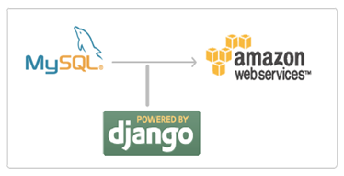
Many of users use Amazon S3 to backup their mysql databases. Here is an automated script which does this task of taking the backup of a mysql database and then moving it to the Amazon S3.

Slide 4
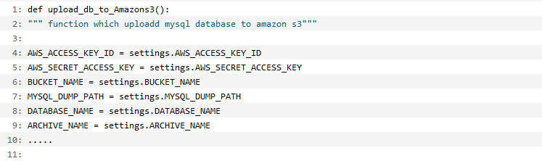
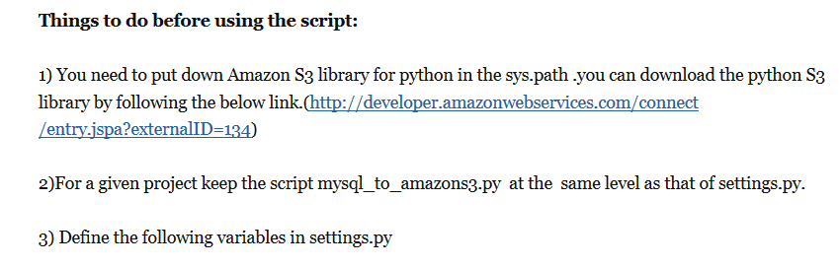

Slide 5
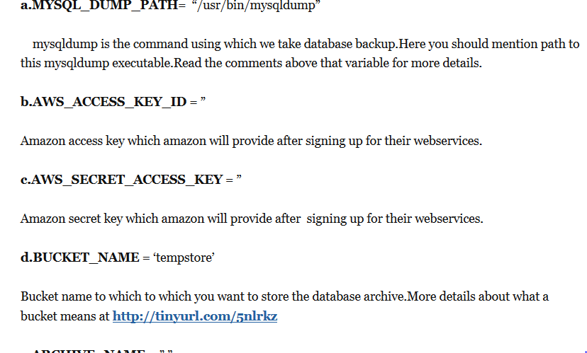

Slide 6
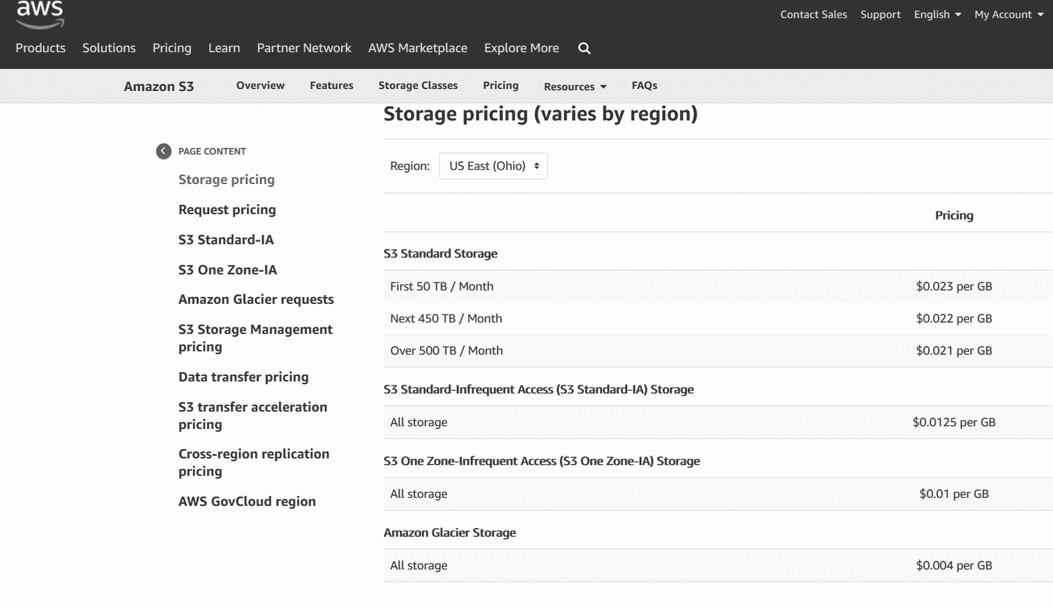
NO MONEY! ☹ SO!! OPEN SOURCE ☺

Slide 7
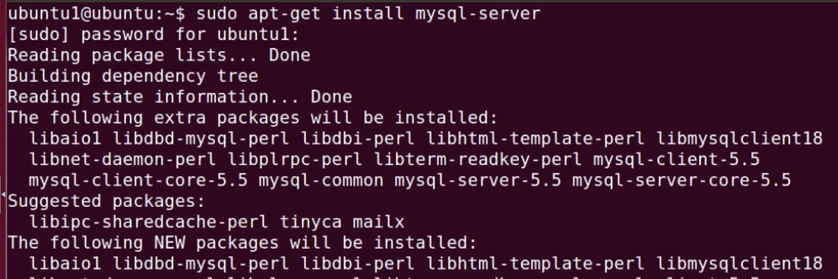
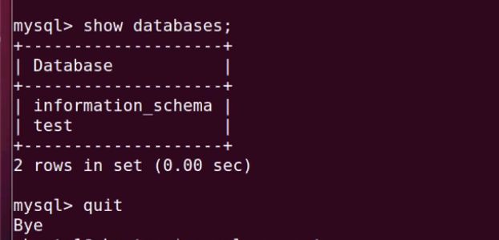

Slide 8
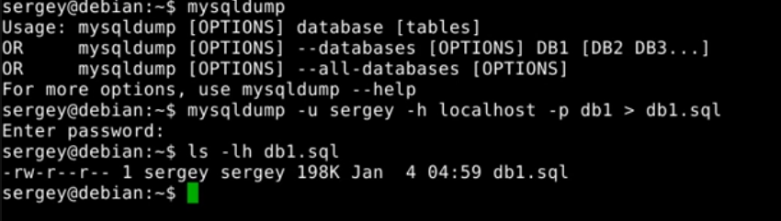

Slide 9
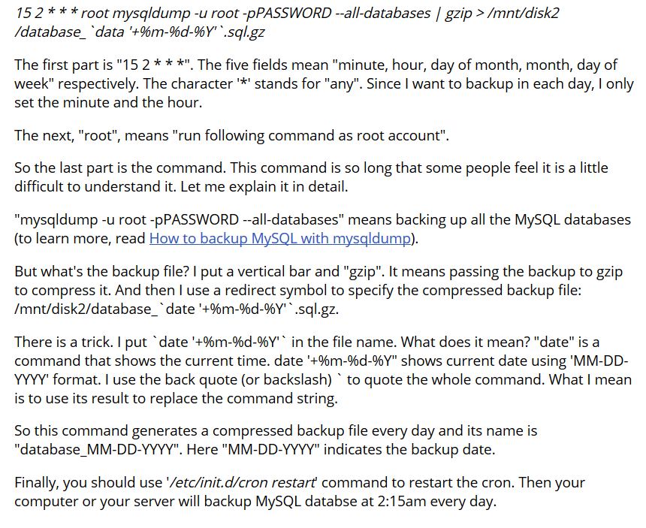

Slide 10
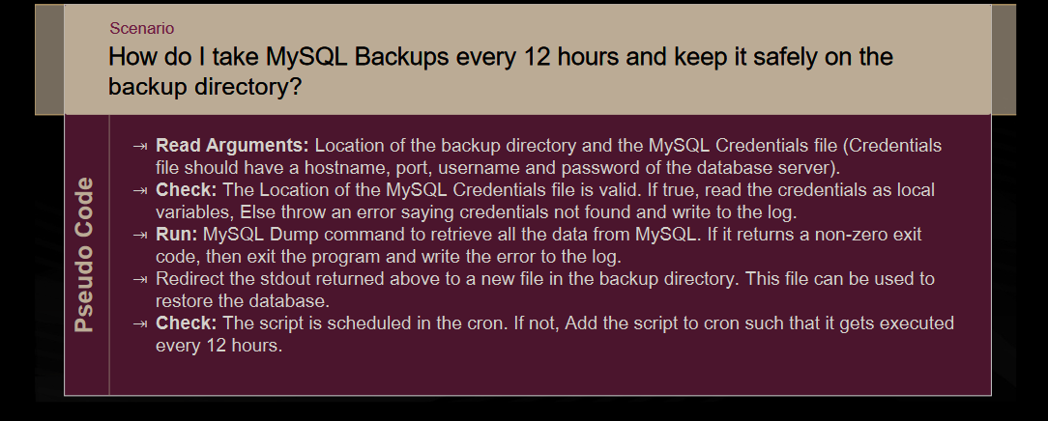

Slide 11
reference
https://www.jotform.com/blog/how-to-backup-mysql-database/

